Slide 1
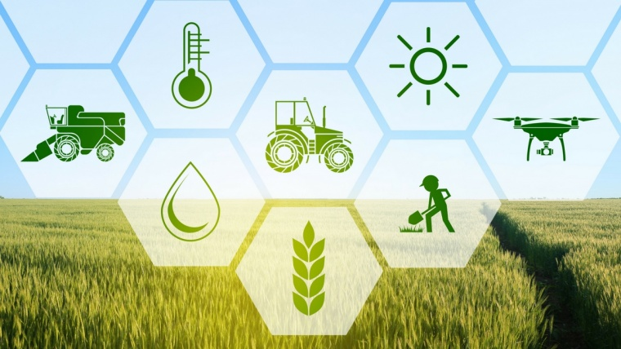
Innovating Agriculture Economy
By
Agriculture Group (MUHAMMAD HAFEEZ)

Slide 2
Outline
Introduction
Paradigms of Agriculture
Challenges for Sustainable Agricultural sector
An overview for ICT in Agriculture
Solutions to Challenges of Agricultural sector
Future prospective of agriculture economy

Slide 3
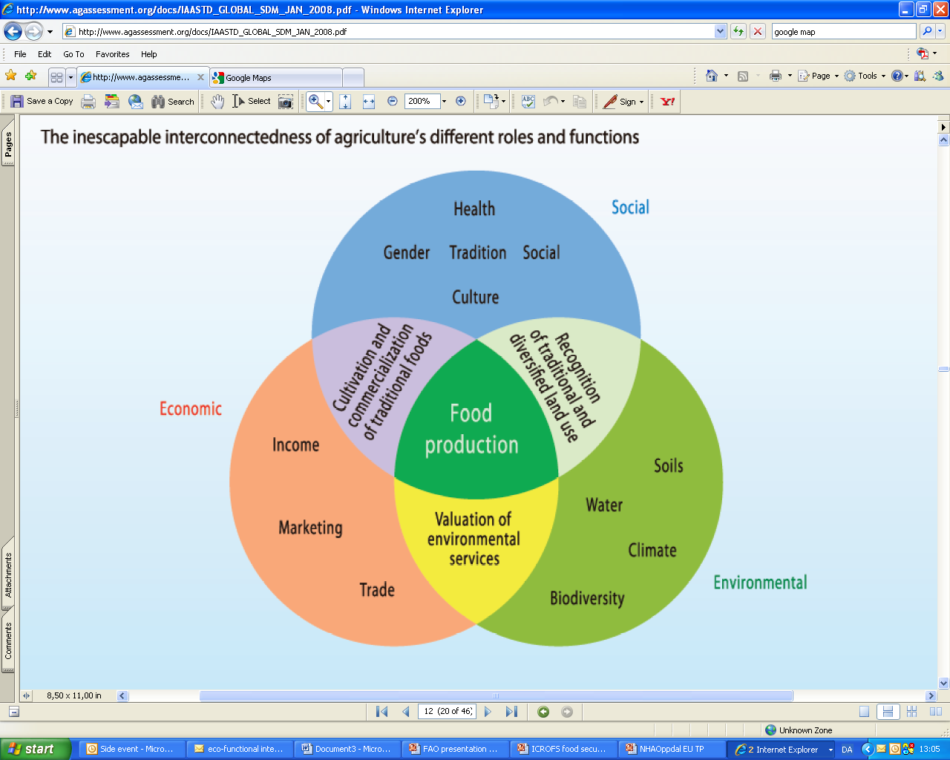
Introduction
The word agriculture has been derived from the Latin word “agricultura” which is the combination of ager, "a field" and “cultura”, "cultivation” .Agriculture is an important sector and considered the backbone of economy

Slide 4
Paradigms of Agriculture
 | Traditional Agriculture Prior to 1950 | Modern Agriculture 1950-1985 (Green Revolution) | New Agriculture 1985 to date
Technology | Relatively Constant Technology | Mechanization-Agrochemical - Better Seeds and Breeds | Information Technology, Biotechnology IoTs, AI, ML, Block chain
Organization | Relatively Stable | Labour Saving - Yield Enhancing - Intensification - Specialization - Concentration | Quality Orientation, Protecting the Environment - Direct and Ethical Marketing -New Products
Social Impact | Static Rural Society | Dynamic Structural Change | - Continuing Structural Change - Rural Development - Direct Payments
Driving Forces | Driven by Tradition | - Driven by Economies of Scale (produce more, faster, easier) | - Driven by Markets Consumer Preferences and Information
Innovators | individuals - “Local Geniuses” - Outsiders | - Technical Experts - Sector-Specific Innovation | - Social Experts - Social and for-profit hybrid enterprises - Strategic Innovation
Scope | Productivity | Input-output relationships | Farm-based, Beyond the farm gate
Role of policy | set priorities and allocate resources for research | set priorities and allocate resources for research in consultation with different stakeholders | Integral part of innovation capacity. Strengthening enabling environment and support system coordination
Source: Robert Chambers and Andy Hal (2005 ), OECD, (2002-2010) and FAO (2017)

Slide 5
Challenges for Sustainable Agricultural sector
Abundant food insecurity (FAO:Food and Agriculture Organization, 2006, 2017)
Demand for food will increase and Urbanization (Evans, 2009, and WHO: World Health Organization)
70% of the world’s poor live in rural areas (< USD 2/day). (source: FAO; Food and Agriculture Organization (United Nations)
Unsustainable use of natural production factors such as soil, biological diversity and water (Pimentel et al., 1995; FAO, 2003, 2017)
60 % of ecosystem services are degraded which causes to increase the frequency of droughts and floods (Millennium Ecosystem Assessment, 2005)
Intensive agriculture is depends on high energy but could be energy self-reliant and could mitigate GHG emission considerably (Smith et al., 2007)
Agriculture is insufficiently prepared to cope with unpredictability and adaptation to climate change (Lobell et al., 2008)
Food waste: Between 33 percent to 50 percent of all foods produced globally is never eaten, and the value of this wasted food is more than $1 trillion. To put that in perspective, US food waste represents 1.3 percent of total GDP. Food waste is a massive market inefficiency (3rd largest emitter of greenhouse gases after China and the US, if food waste were a country ) (FAO, 2016)

Slide 6
An overview for ICT in Agriculture
Crop cultivation
and harvesting
Post harvest
Pre-cultivation
Land preparation
Marketing
Crop selection
Land selection
Sowing
Transportation
Input management
Calendar definition
Packaging
Water management
Access to credit
Fertilization
Food processing
Pest management
Main phases in the agriculture sector

Slide 7
Information produced/needed
Pre-cultivation
Crop cultivation
and harvesting
Post harvest
Crop selection
Land preparation
Marketing
Land selection
Sowing
Input management
Transportation
Calendar definition
Access to credit
Water management
Packaging
Fertilization
Food processing
Pest management
Information for the sound
management of the whole cropping
activities, including the resilience to
natural (e.g. weather) and
anthropogenic shocks
Information for
the selection of the best crop
according to their land,
access to input and credit,
market (Cost-Benefit), etc.
Information related to
post-harvest techniques
and tools, marketing and
transportation infrastructures,
etc.

Slide 8
ICT Application
Decision Support System (DSS), modeling software, electronic/mobile(e/m)-learning,
e/m-consulting, Knowledge Management Systems (KMS)
Pre-cultivation
DSS, GIS, Remote sensing, e/m-consulting, KMS, sampling devices connected to networking tools
Crop selection
Land selection
Calendar definition
KMS, e/m-consulting, e/m-learning, DSS, GIS
Access to credit
Networking tools (mobile phones, radios, wireless networks), Management Information System (MIS), e-commerce and mobile commerce

Slide 9
ICT Application
KMS, e/m-learning, e/m-consulting, GPS, GIS, computer controlled devices, machine2machine communication and sensor networks
Crop cultivation
and harvesting
GPS, GIS, e/m-learning, e/m-consulting, computer controlled devices, m2m communication, sensor networks
Land preparation
Sowing
DSS, MIS, GPS/GIS, e/m-learning
Input management
Water management
DSS, GIS, MIS, sensor networks, m2m communication
Fertilization
DSS, GIS, MIS, sensor networks, m2m communication
Pest management
DSS, GIS, management information system, sensor networks, m2m communication

Slide 10
ICT Application
Networking tools (mobile phones, lo-fi technologies) for broadcast
Post harvest
Marketing
GPS, GIS, MIS, DBMS, tracing devices, m2m communication
Transportation
Packaging
Tracing devices, KMS, e/m-learning, e/m-consulting, GPS, GIS
Food processing
Farm to fork tracing tools – GPS, RFID, GIS,
DBMS, MIS, KMS, e/m-learning, e/m-consulting, machine2machine communication

Slide 11
Mind map for ICT in Agriculture
KMS, e/m-learning, e/m-consulting, GPS, GIS, computer controlled devices, machine2machine communication and sensor networks
GPS, GIS, e/m-learning, e/m-consulting, computer controlled devices, m2m communication, sensor networks
DSS, MIS, GPS/GIS, e/m-learning
Decision Support System (DSS), modeling software, e/m-learning, e/m-consulting, Knowledge Management Systems (KMS)
Pre-cultivation
Crop cultivation
and harvesting
Post harvest
Networking tools (mobile phones, lo-fi technologies) for broadcast
Crop selection
Land preparation
Marketing
DSS, GIS, Remote sensing, e/m-consulting, KMS, sampling devices connected to networking tools
GPS, GIS, MIS, DBMS, tracing devices, m2m communication
Land selection
Sowing
Transportation
Input management
Tracing devices, KMS, e/m-learning, e/m-consulting, GPS, GIS
KMS, e/m-consulting, e/m-learning, DSS, GIS
Calendar definition
Packaging
Water management
Networking tools (mobile phones, radios, wireless networks), Management Information System (MIS), e-commerce and mobile commerce
Access to credit
Farm to fork tracing tools – GPS, RFID, GIS,
DBMS, MIS, KMS, e/m-learning, e/m-consulting, machine2machine communication
Fertilization
Food processing
Pest management
DSS, GIS, MIS, sensor networks, m2m communication
DSS, GIS, MIS, sensor networks, m2m communication
DSS, GIS, management information system, sensor networks, m2m communication

Slide 12
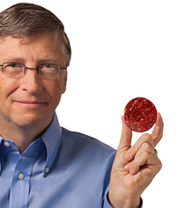
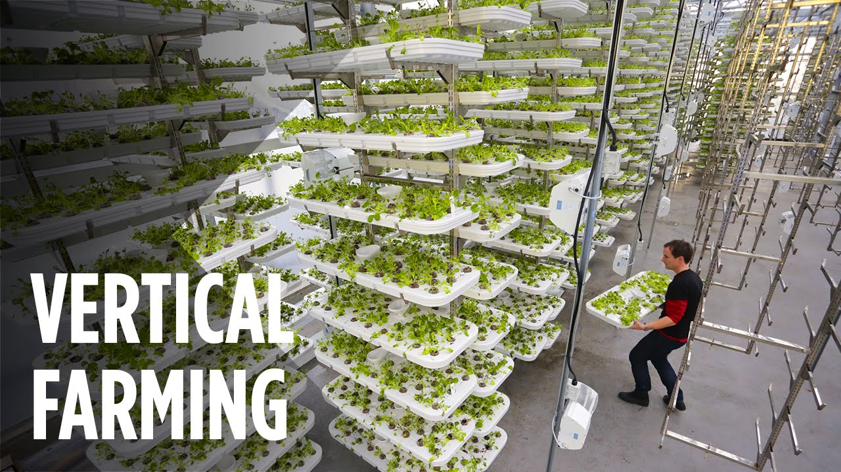
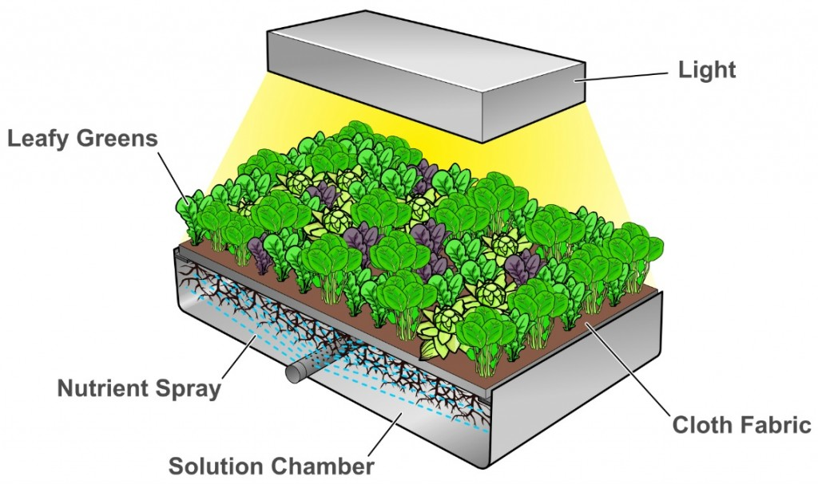
Solutions to Challenges of Agricultural sector
Bill Gates and Richard Branson Back Startup That Grows “Clean Meat”
IKEA, David Chang and the ruler of Dubai invest $40 million in AeroFarms vertical farming
AeroFarming

Slide 13
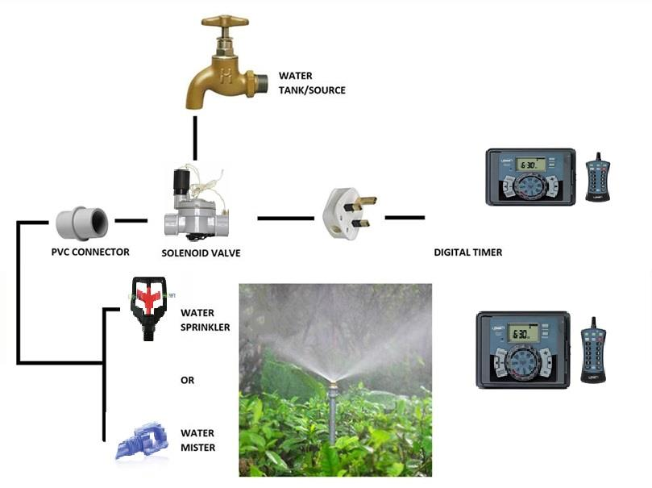
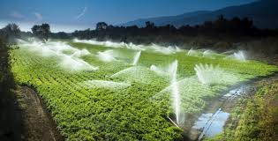
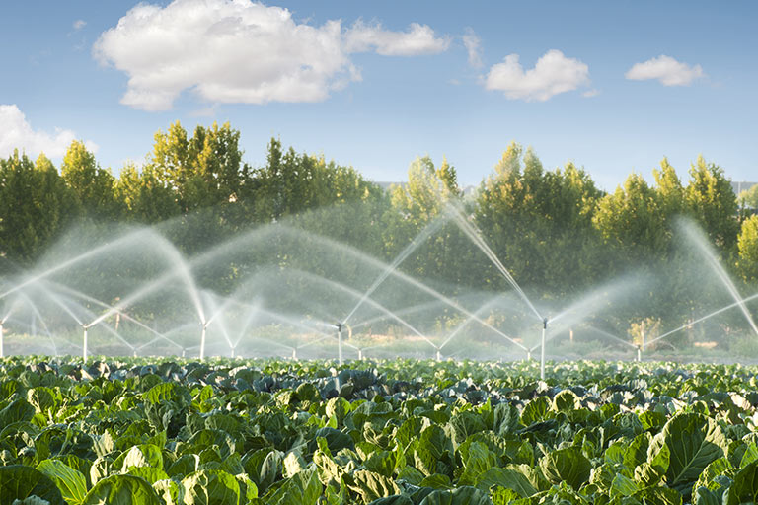
Solutions with Cross-industry technologies and applications
Internet of Things (IoT): Digital transformation is disrupting the agricultural world. IoT technologies allow correlations of structured and unstructured data to provide insights into food production. IoT makes better water management when coupled with sensors, data and other machinery.

Slide 14
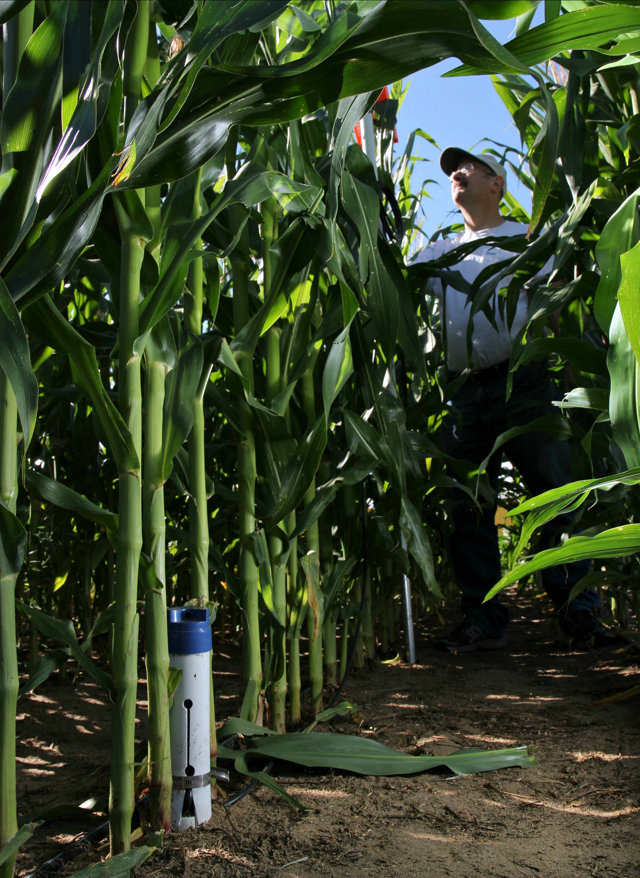
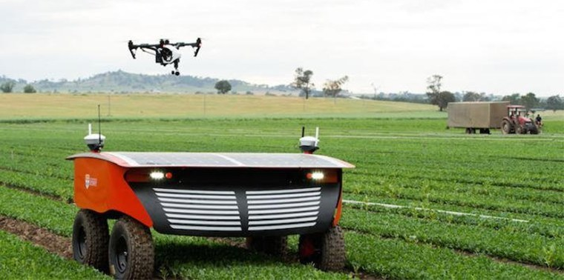
Cont..
Moisture precision sensors: Moisture precision sensors in a cornfield are used to assure that the crops are receiving the right amount of water and nutrients.
Automation of skills and workforce: By the 2050, the UN projects that two-thirds of the world’s population will live in urban areas, reducing the rural workforce. New technologies will be needed to ease the workload on farmers: Operations will be done remotely.
Autonomous Vehicles
Moisture precision sensors

Slide 15
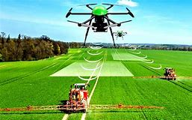
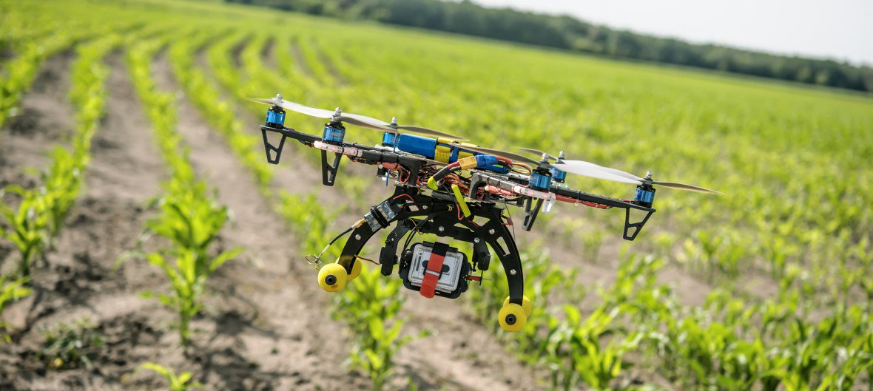
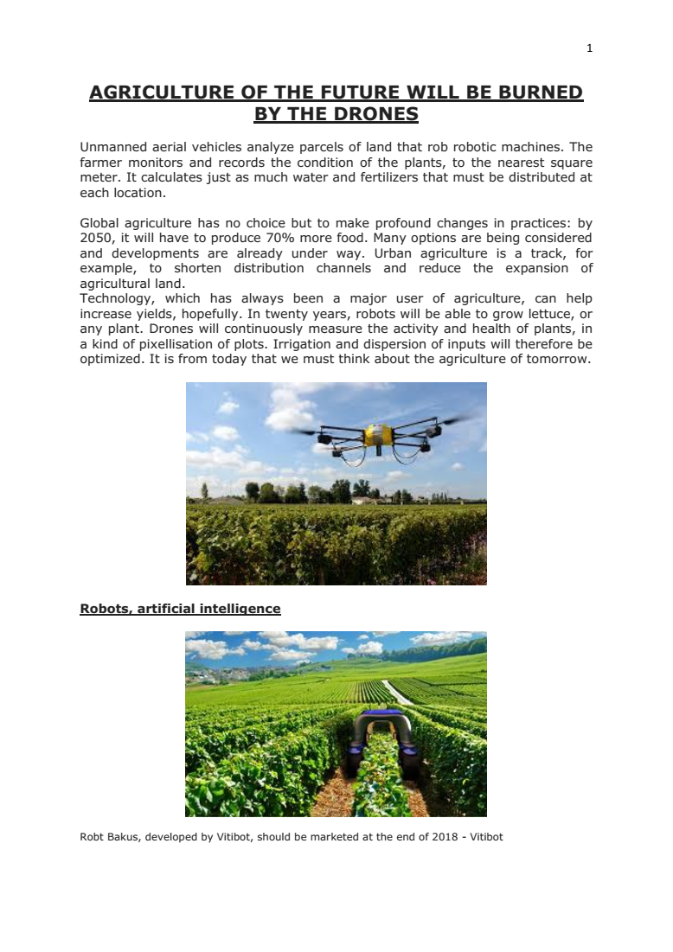
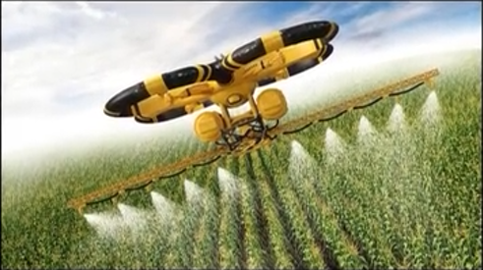
Drone Technology
Drone technology is giving agriculture a high-tech makeover. Here are six ways drones will be used throughout the crop cycle:
Soil and field analysis :By producing precise 3-D maps for early soil analysis, drones can play a role in planning seed planting and gathering data for managing irrigation and nitrogen levels.
Planting: Start-ups have created drone-planting systems that decrease planting costs by 85 percent. These systems shoot pods with seeds and nutrients into the soil, providing all the nutrients necessary for growing crops.
Crop spraying: Drones can scan the ground, spraying in real time for even coverage. The result: aerial spraying is five times faster with drones than traditional machinery.
Crop monitoring: Inefficient crop monitoring is a huge obstacle. With drones, time-series animations can show the development of a crop and reveal production inefficiencies, enabling better management.
Irrigation: Sensor drones can identify which parts of a field are dry or need improvement.
Health assessment: By scanning a crop using both visible and near-infrared light, drone-carried devices can help track changes in plants and indicate their health—and alert farmers to disease.

Slide 16
Shared Economy
Food Sharing and Crowd farming:
Finally, the sharing economy and crowdsourcing also have a place in preventing food waste.
Technology has enabled communities to share their goods and services. This first became popular in ride sharing and house sharing, and now it is being applied to every industry, including food.
Olio, founded by social entrepreneurs, has built an app connecting people with their neighbours and local shops so that surplus food can be shared, rather than be discarded.
Another social entrepreneurial project, Naranjas del Carmen, has developed the concept of Crowdfarming. Naranjas del Carmen has created a system in which the person has ownership over the trees and land that the farmer cultivates. In this way, the fruit of those trees goes to their owners, creating a direct link between production and consumption and avoiding overproduction and waste along the value chain.

Slide 17
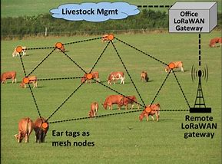
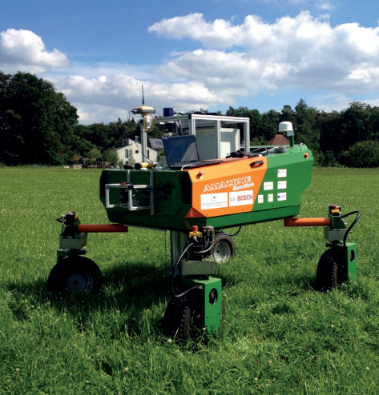
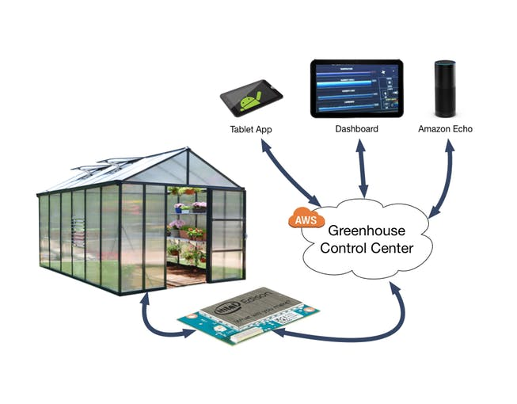
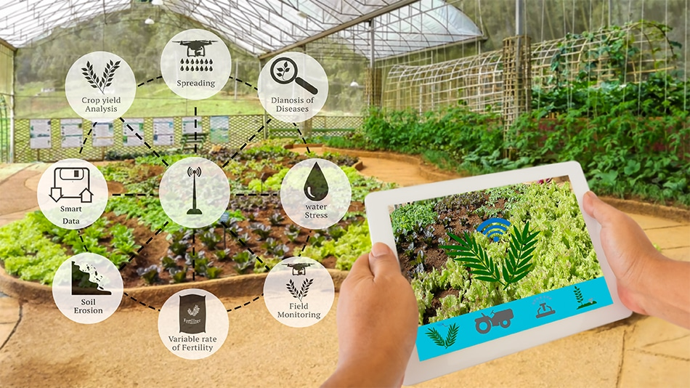
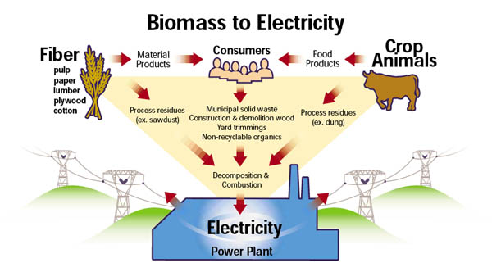
Future prospective of agriculture economy
1. Innovation and Technology Players in Agricultural Economy
Agricultural Drones
Artificial Intelligence, Big Data and Robotics
Monitoring and Controlling Crop Irrigation Systems via Smartphone
Ultrasounds for Livestock
Application of Agricultural Products as a source of Renewable Energy

Slide 18
Cont..
2. Blockchain
technology behind Bitcoin and other cryptocurrencies, allows for highly secure digital transactions and recordkeeping. While blockchain has mainly been used in virtual currencies, it can also be applied to other types of transactions, including agricultural ones.
Blockchain can reduce inefficiencies and fraud and improve food safety, farmer pay, and transaction. By improving traceability in supply chains, it can enable regulators to quickly identify the source of contaminated foods and determine the scope of affected products during contamination incidents.
The transparency of blockchain can also help fight food fraud. As consumer demand for organic, GMO-and antibiotic-free food soars, the news is rife with cases of fraudulent labelling. The smallest transactions— whether at the farm, warehouse, or factory—can be monitored efficiently and communicated across the entire supply chain when paired with IoT technologies, such as sensors and RFID tags.
Maersk, a shipping and logistics company, has intra-continent supply chains that involve dozens of personnel and hundreds of interactions. They estimate that blockchain could save them billions by improving efficiencies that reduce fraud and human error.
The benefits of openness extend to all honest market participants. Blockchain technologies can prevent price extortion and delayed payments while simultaneously eliminating middlemen and lowering transaction fees, leading to fairer pricing and helping smallholder farmers capture a larger part of their crop value.

Slide 19
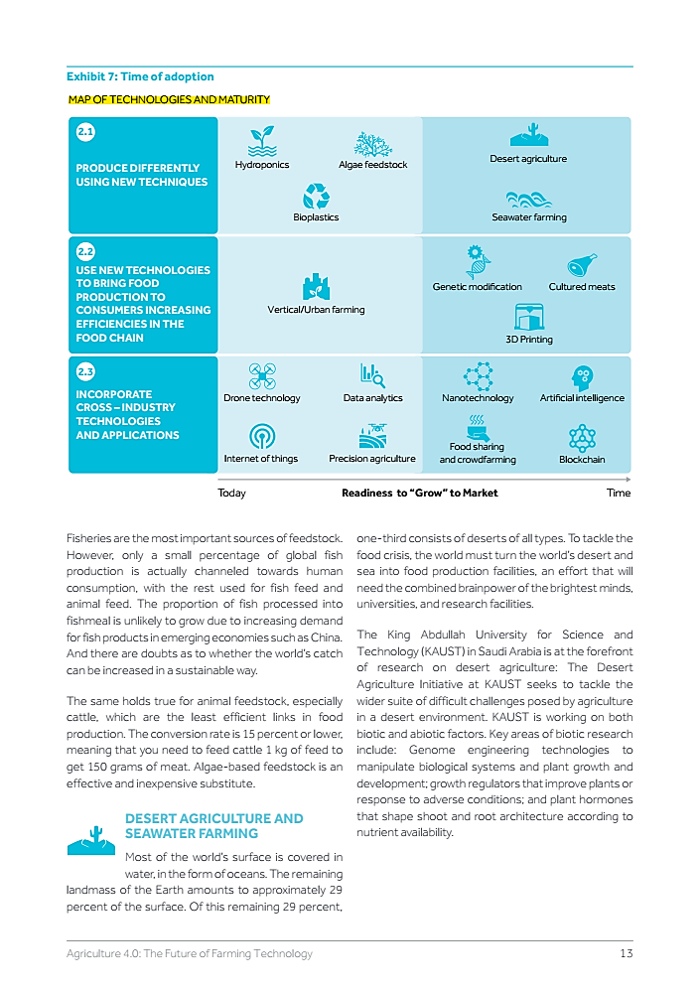
Future technologies and maturity of Agricultural Economy
Source: OECD,FAO,(2017)

Slide 20


